Slide 1
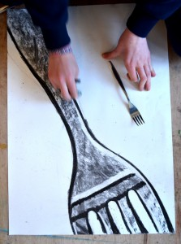

Slide 2
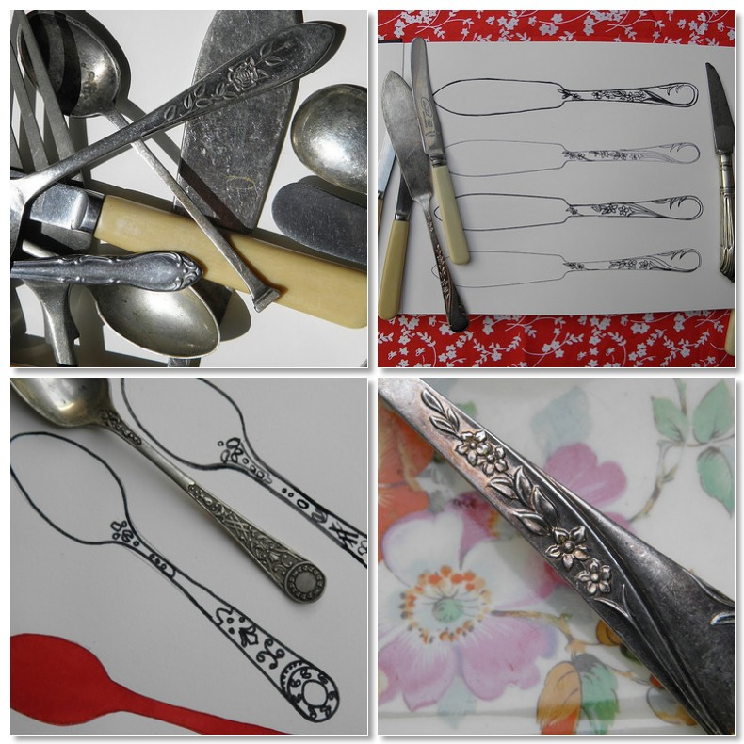

Slide 3
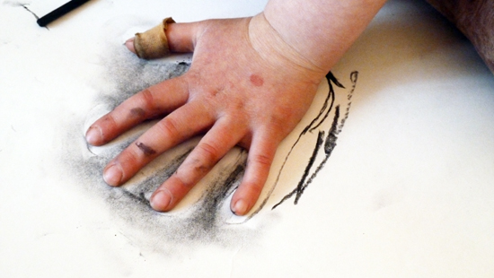

Slide 4
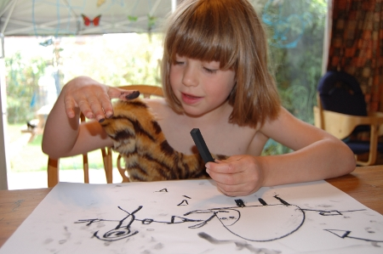

Slide 7
https://www.ted.com/talks/ken_robinson_says_schools_kill_creativity?language=sr#t-70758

